Slide 1

Welcome to Year 6

Slide 2
Who are we?
Mrs Saunders – class teacher in Willow
Mrs Smitherman – class teacher in Willow
Mrs Macwhinnie – class teacher in Silver Birch
Miss Dawson – class teacher in Silver Birch
Miss Stenning – learning support assistant Silver Birch
Mrs Tan and Mrs Langhorn - learning support assistants Willow
Mrs Duarte - PPA teacher Willow

Slide 3

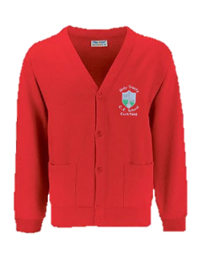

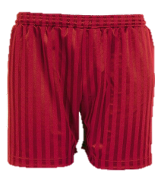
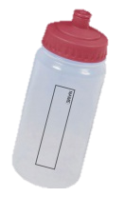

Routines
Start of the school day 8.45- 8.55am– come in through the door at back of the building.
End of the day 3.15pm– children to be collected from the same door or walk home if permission has been given.
PE Kits in school every day.
Wellies
Water bottle
Own pencil cases including black and blue handwriting pens, pencils, glue stick, eraser, ruler, pencil sharpener, coloured pencils.
ALL NAMED PLEASE
Tie hair back
No jewellery/nail varnish
Share achievement and successes in Thursday’s Worship

Slide 4
Organisation/SATs
2 parallel year 6 classes
Interventions organised across both classes.
SATs w/b 9th May
SATs meeting for parents 5th January 3.30pm
We will be preparing your child for the tests but not at the expense of a broad and balanced curriculum.

Slide 5
Autumn Term 2021
Power of Reading book – Stay Where You Are and Then Leave by John Boyne (set in WW1)
Maths– White Rose recovery curriculum
Geography/History – World War 1 and immersion block on Egyptians after half term
Science – light, animals including humans
Computing – internet safety, coding, website design and computing systems and networks
Art/DT–Poppies and shaduf making
RE – Buddhism
PE –orienteering, gym, dance, ball skills
French- A L’Ecole and La Seconde Guerre Mondiale.
PSHE - emotional health and wellbeing and digital media literacy.
Music - ‘Happy’ and Classroom Jazz.

Slide 6
Other Information
Ambassador presentations and elections – to be held on Monday 27th September
Memory sticks in by Wednesday 22nd September
Liddington PGL residential provisional booking is for Friday June 24th to Monday June 27th.
Hands on History workshop Tuesday 12th October

Slide 7

Positive Language
Fixed Mind-set | Growth Mind-set
I’m not good at this | What am I missing?
My work is good enough | Is this really my best work?
This is too hard | This may take time and effort
I'm not as good as him /her | I'm going to ask them for help
Compared to the rest of the group / year I’m rubbish | I’m going to try and improve my previous score.

Slide 8
Homework
Read with your child daily
Spellings tested every Monday. They will be sent home in a half termly block. Activities will be on Spelling Shed.
Topic/writing every half term
Maths homework weekly –usually Mymaths - Fridays
Times Tables – children must know all times table facts up to 12 x 12.
SATs related homework after Christmas
Notes:
reading with your child daily wherever possible – research shows that chn who read regularly achieve better at school
Spellings – write in sentences, wordsearches, crosswords
homework expectations – weekly spellings, homework grid
Mighty Multiples -very important to know all off by heart

Slide 9
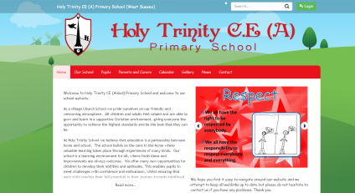
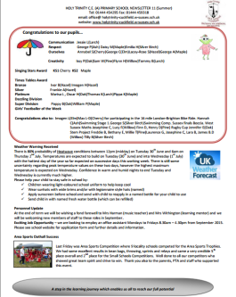

Communication
Parentmail
Phone call
Parent/Carer Appointments in November
Notes:
methods of communication eg email to school office, note, letter, phone call, meeting, popping in
Please pop in to see us as soon as a problem arises

