Slide 1
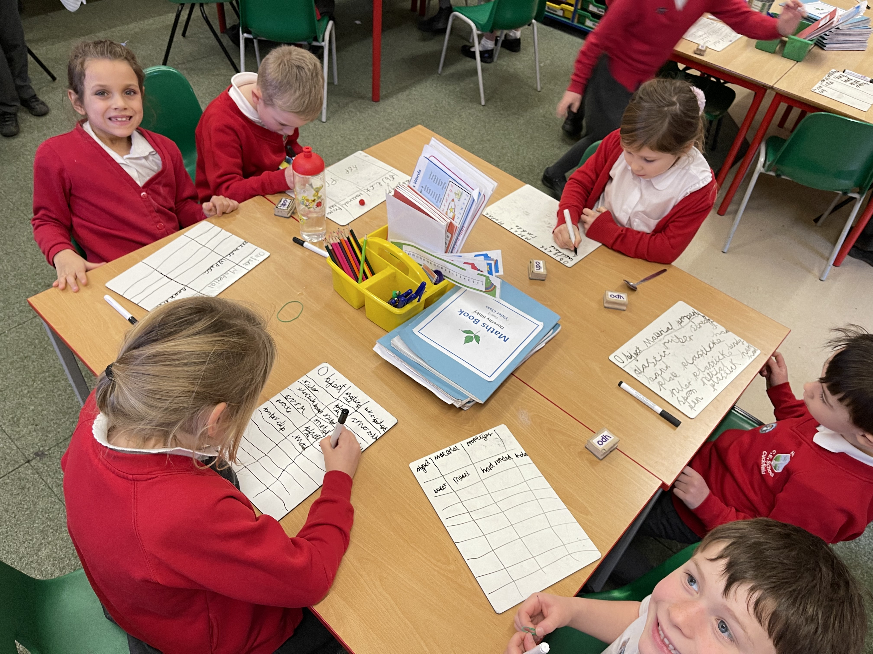
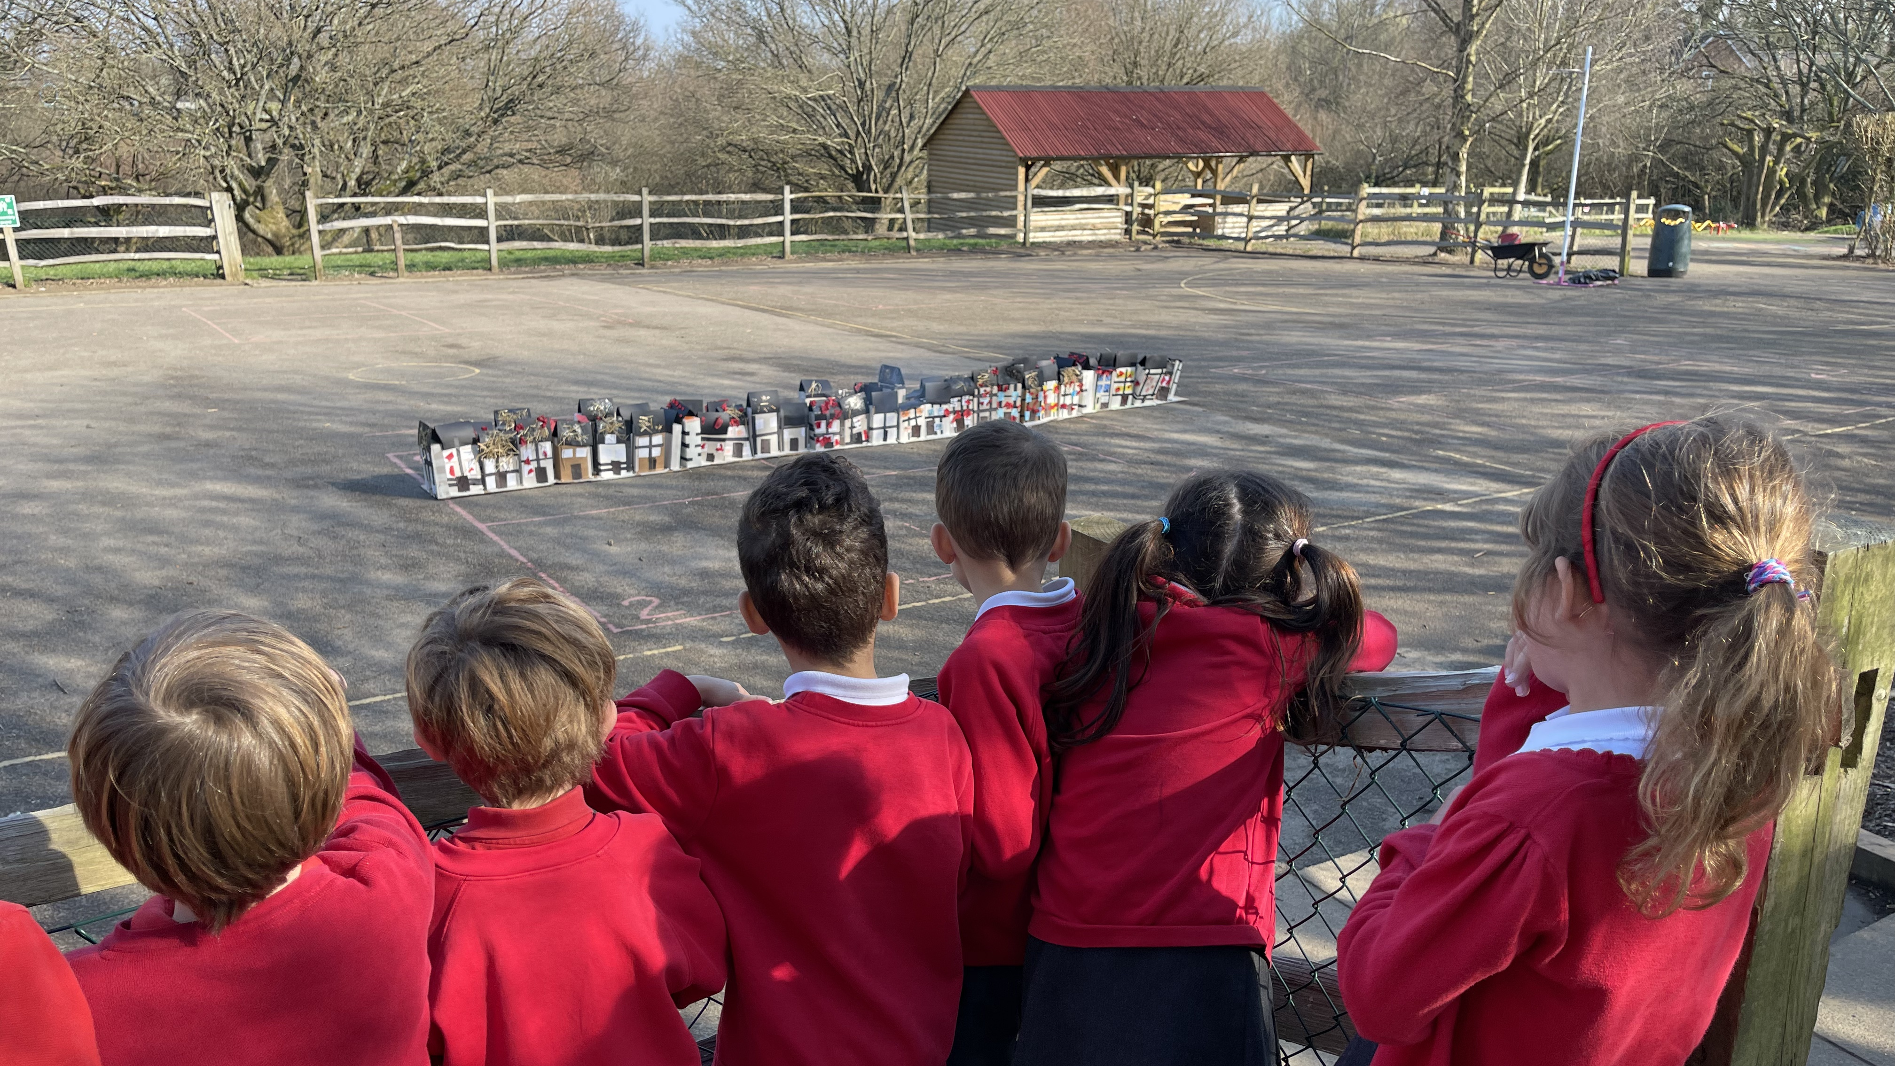
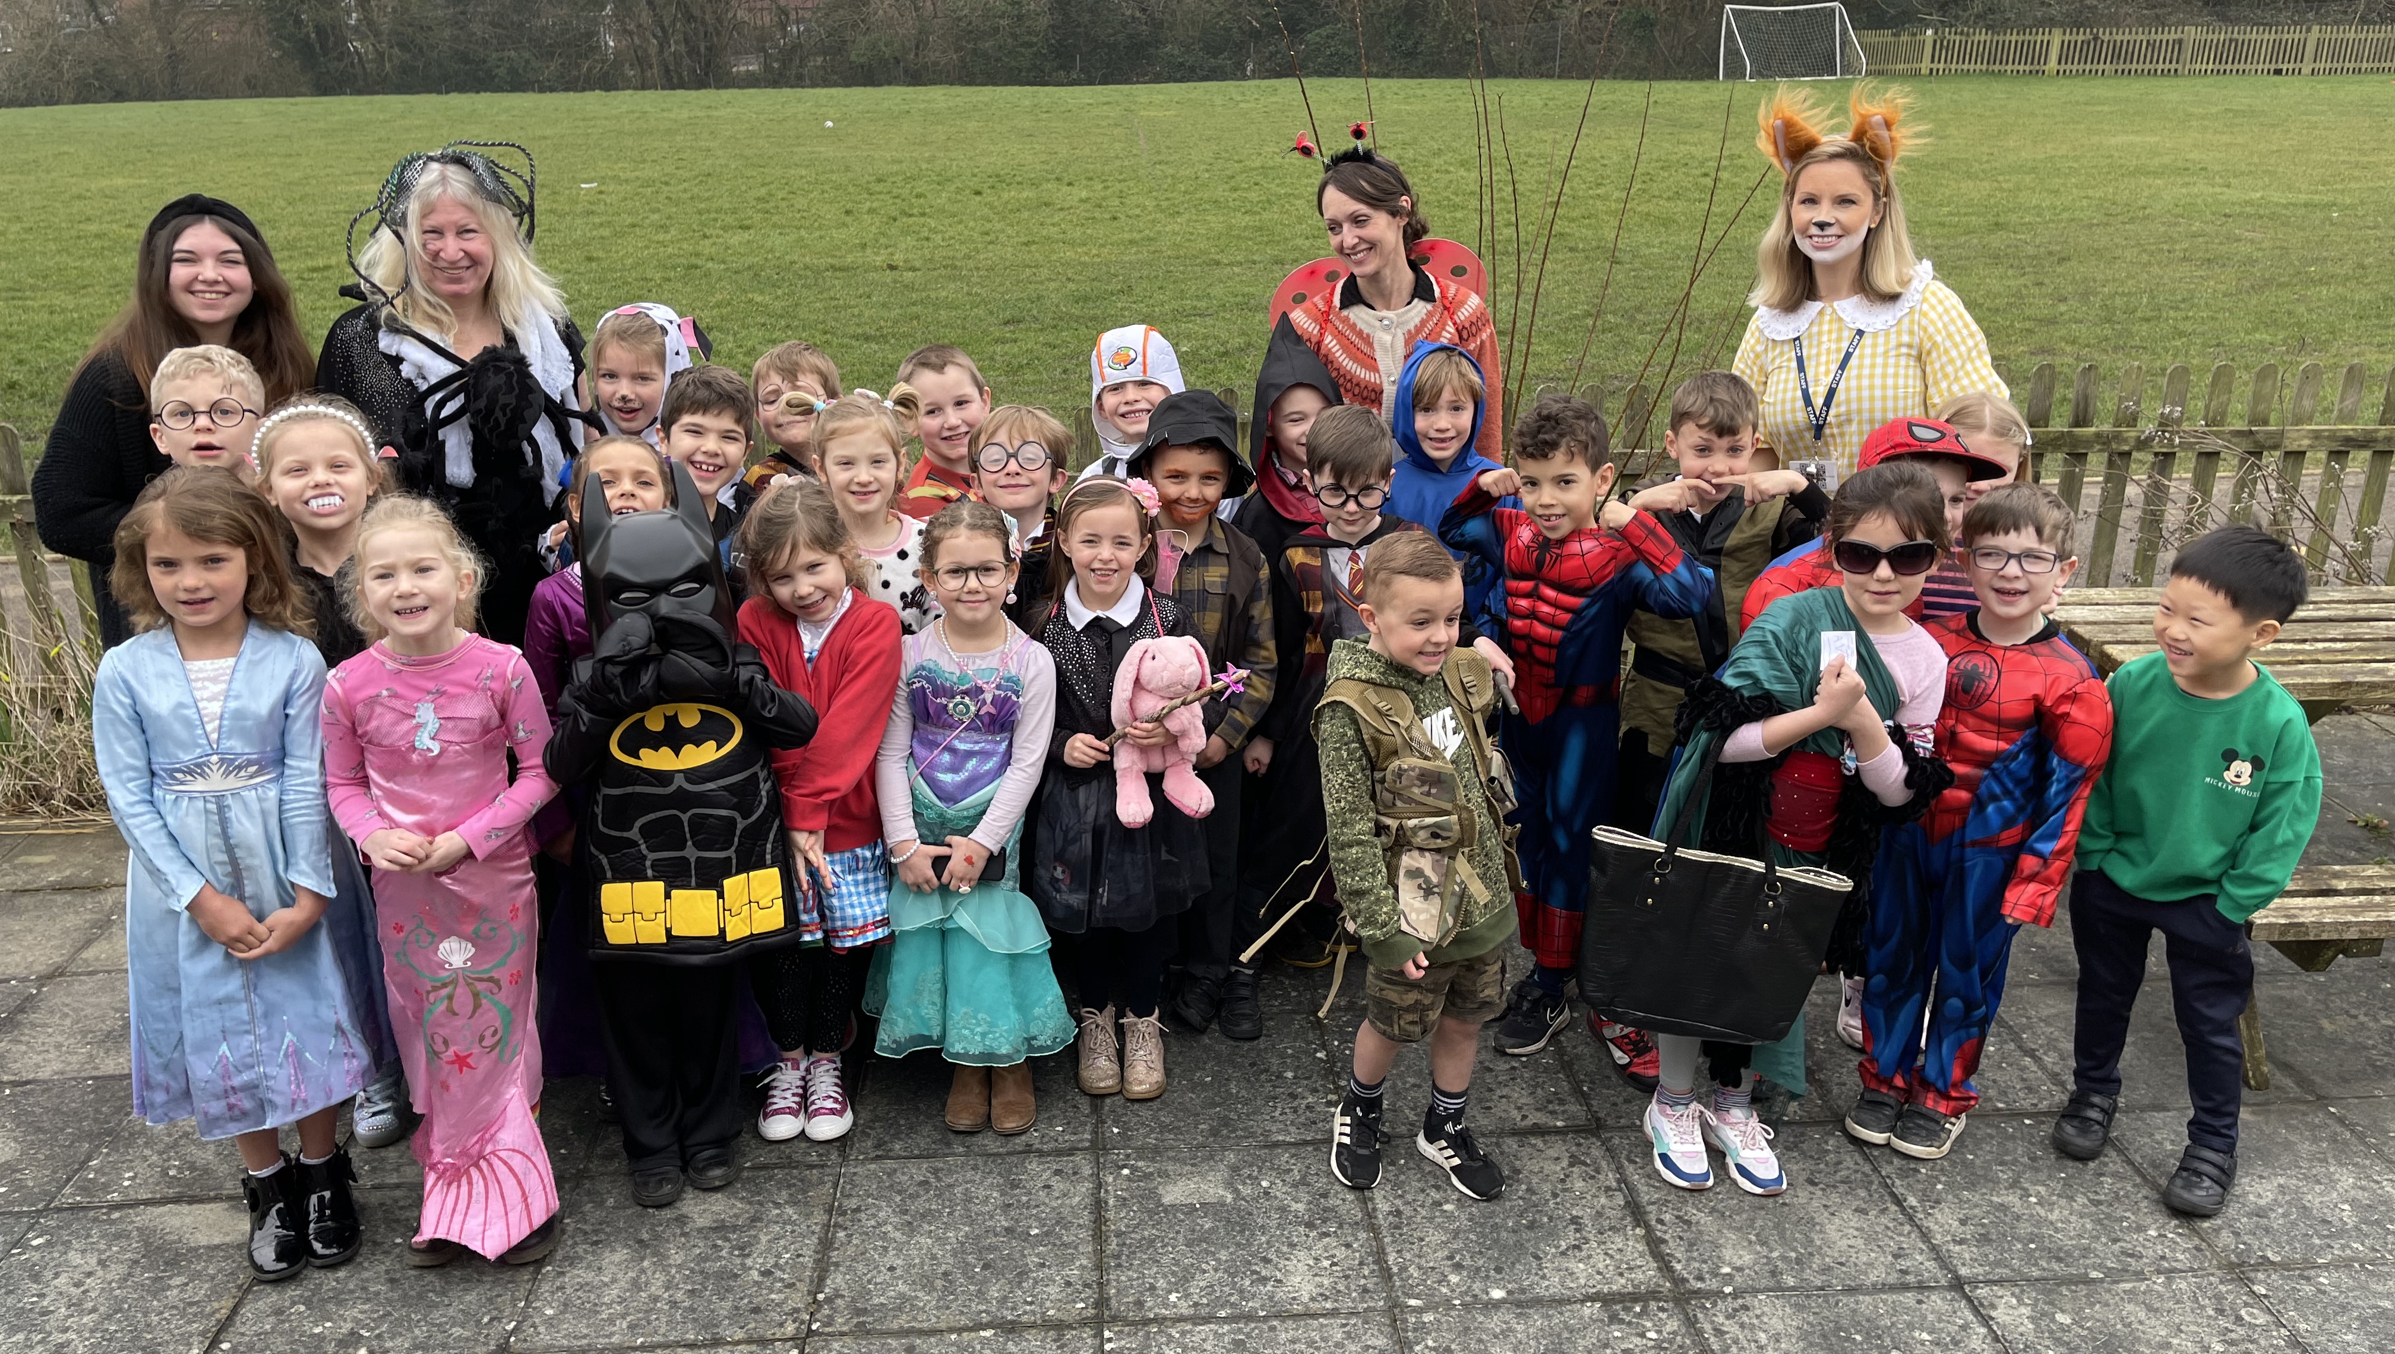
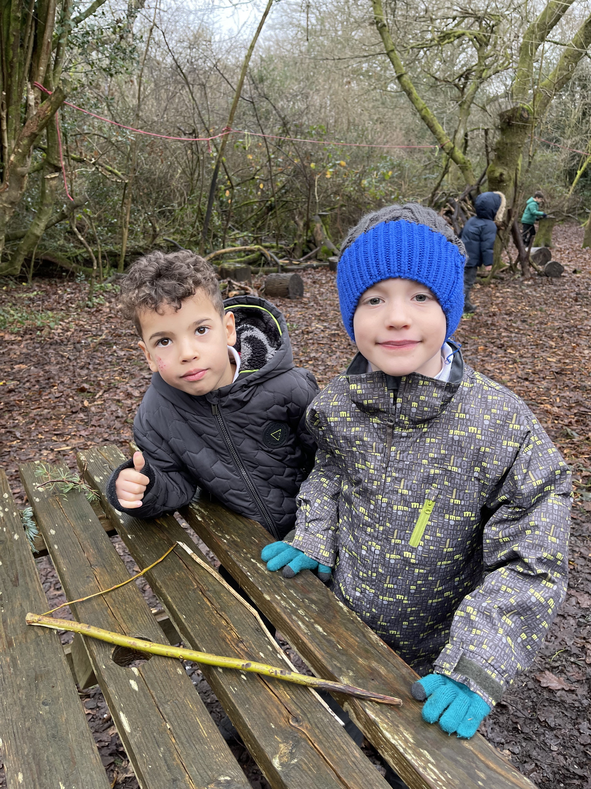
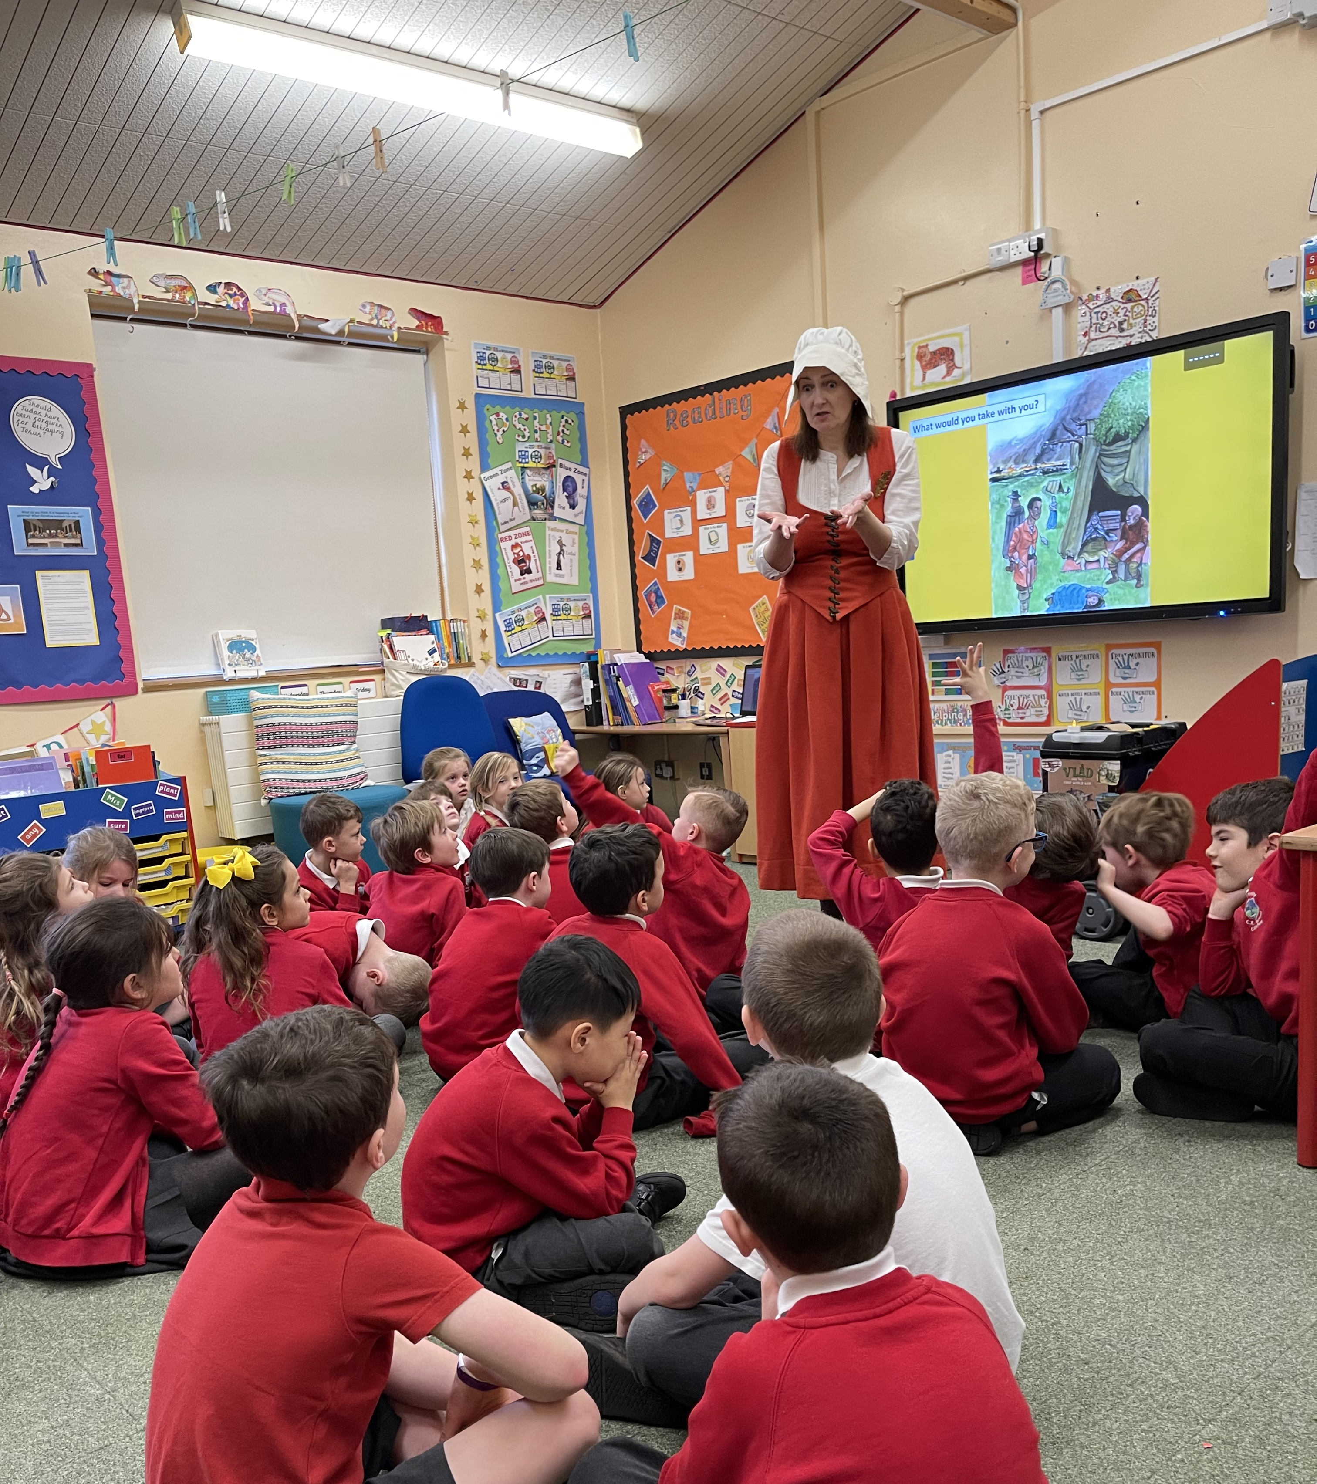
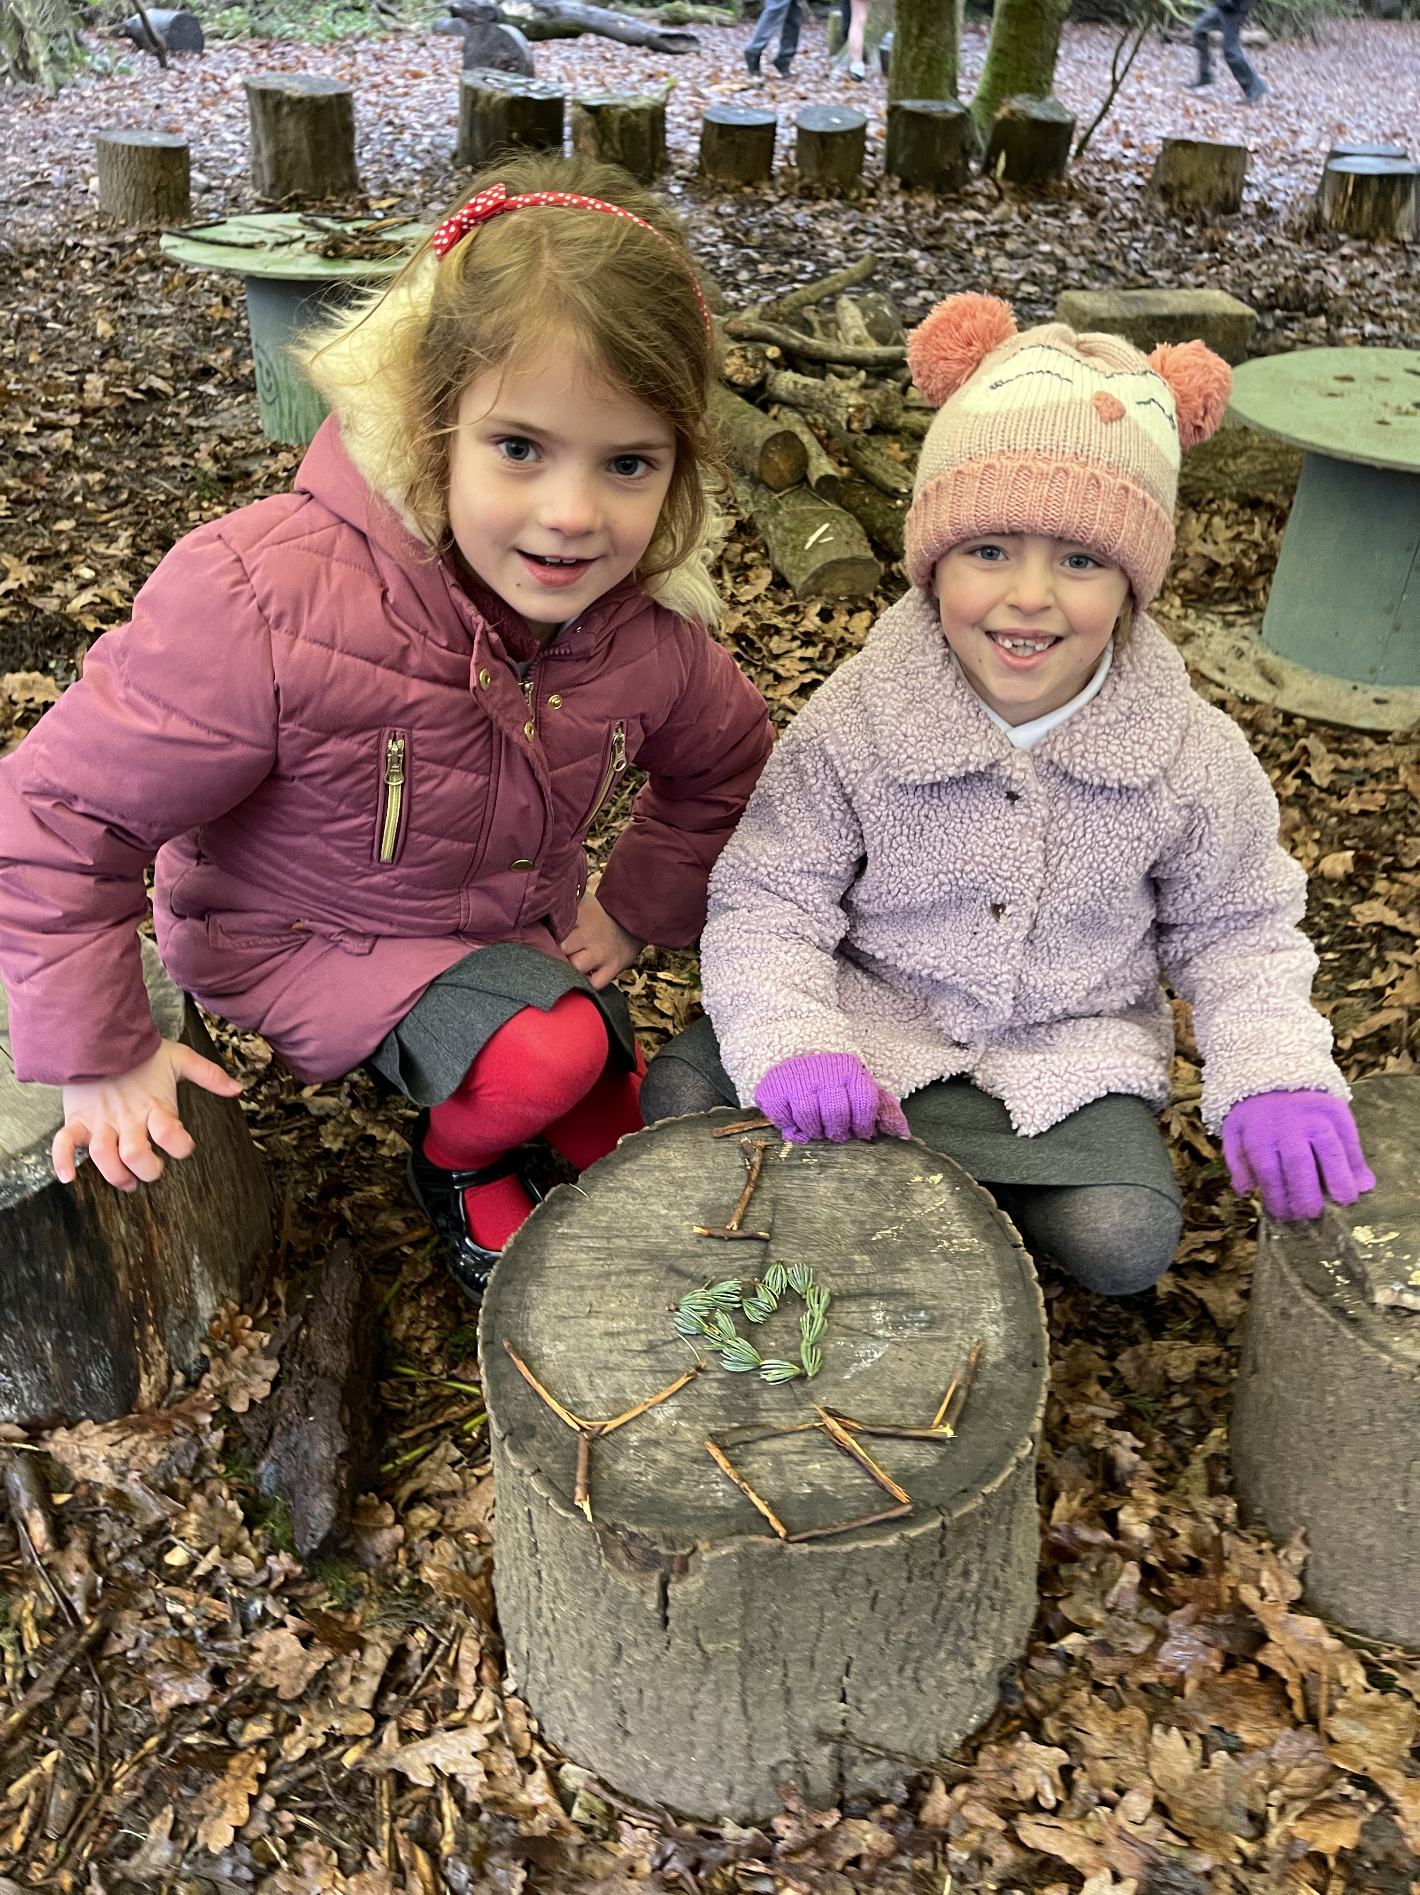
Welcome
Year 2 SATs
Parents’ Meeting
Wednesday 23rd March 2022

Slide 2
What are SATs?
SAT’s stand for Standardised Assessment Tests. We are required by the government to assess all children against a national framework to establish their attainment towards the end of Year Two. The subjects that we are required to assess are:
Maths - tests
Reading - tests
Writing – SPAG tests plus ongoing teacher assessment
Science – no test (teacher assessment only)
The children will be assessed against key objectives from the curriculum which the children have been following since Year One.

Slide 3
What are SATs?
The results will be given as a scaled score which will result in the children being placed in one of three main categories:
Working Towards the Expected Standard
Working At the Expected Standard
Working At Greater Depth within the Expected Standard
Please note that, for Science, the only category available is ‘Working At the Expected Standard’ or ‘working below’ therefore children will simply be assessed as to whether they have, or have not, reached this standard.

Slide 4
What are SATs?
What is meant by ‘scaled scores’?
100 will always represent the ‘national standard’.
Each pupil’s raw test score will therefore be converted into a score on the scale, either at, above or below 100.
The scale will have a lower end point somewhere below 100 and an upper end point above 100.
A child who achieves the ‘national standard’ (a score of 100) will be judged as met ARE (Age Related Expectations).

Slide 5
Year 2 SATs
Year 2 SATS are statutory tests which the children must take towards the end of year 2 to support teachers in making a secure judgement of each child's attainment. However the judgement is mainly based on the teacher assessment which uses a broad range of evidence from across the curriculum and knowledge of how a child has performed over time and in a variety of contexts.
As the children are so young, every effort will be made to make sure that they do not feel under any pressure or undue stress. We will not be using the terms ‘SAT’s’ or ‘tests’ in the classroom. Instead we will refer to them as ‘special work’ that the children will be completing ready to move onto Key Stage 2.

Slide 6
How and when will the SATs be completed?
SATs will run throughout the month of May. The precise days of the tests varies from school to school as we are given a greater degree of flexibility than KS2 SATs. So they will be completed at some point between 1 May 2022 and 31 May 2022.

Slide 7
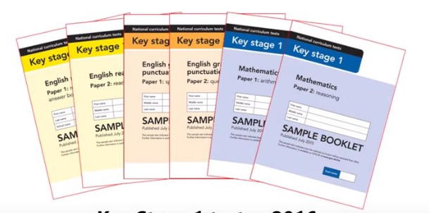
Year 2 SATs Booklets

Slide 8
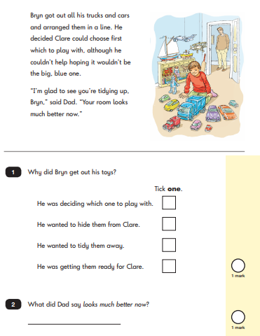
Reading Paper 1
30 minutes approximately
20 marks
Likely to be a mix of fiction and non-fiction.
Children to read and answer questions which are either multiple choice or they will be asked to write a short phrase or sentence.
Later questions involve children making inferences.
Retrieve by using the text to find the answers.

Slide 9
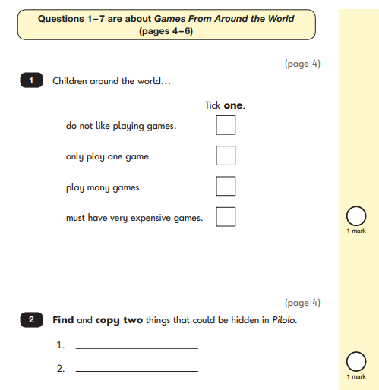
Reading Paper 2
40 minutes approximately
20 marks
All children will sit a 2nd reading paper which will contain a longer, more challenging text.
They will be given 2 booklets – 1 with the text they’ll need to read, 1 with questions in. Likely to be fiction and non-fiction.
Questions will focus on 2 main areas of KS1 reading – explaining their understanding of the words they’ve read and retrieving information from the text.

Slide 10
How can we help at home?
Read your child’s school reading book with them each night and ask them questions about the text. Mix it up by asking questions after each page but sometimes at the end of the whole book or chapter.
Encourage your child to read anything and everything; sign posts, adverts, magazine/newspaper articles, a recipe book etc.
Ask your child comprehension questions about books/stories you have read to them or about films/TV programmes they have watched.

Slide 11
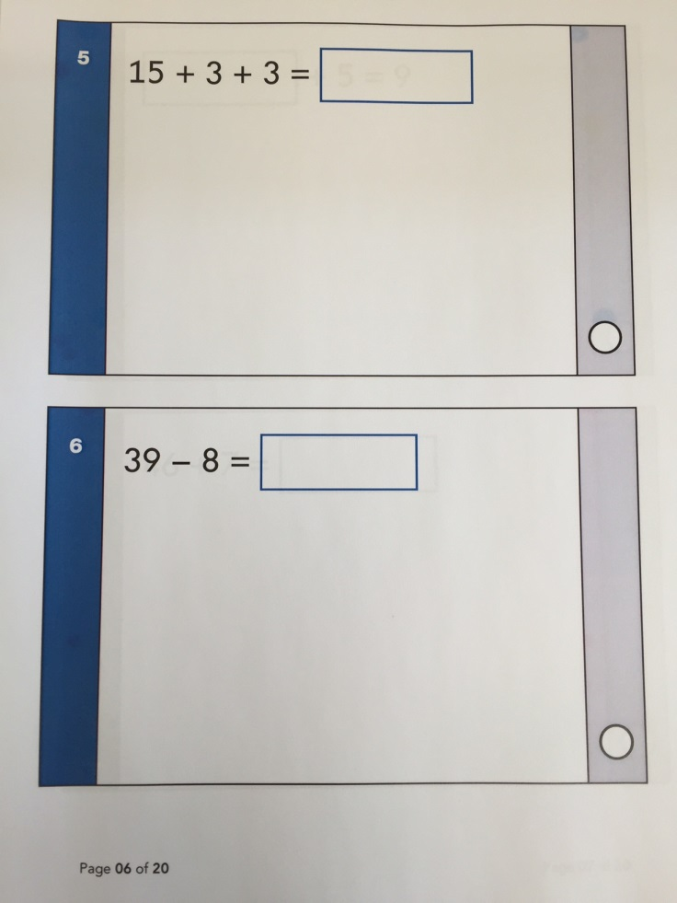
Arithmetic Paper
20 minutes approximately
25 marks
Children are given various calculations to work out with space for jottings
The questions rely on children’s basic knowledge of number facts.
Later questions will involve division and fractions.

Slide 12
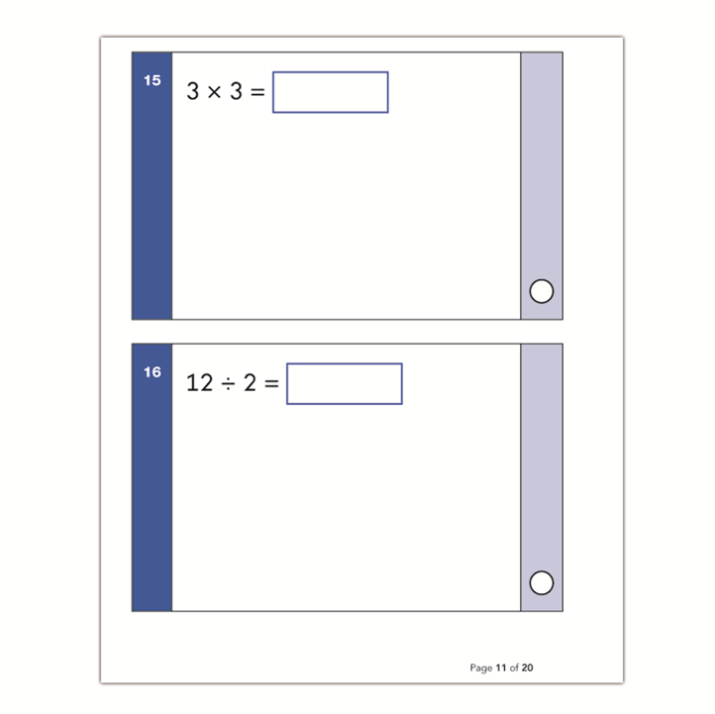
Arithmetic Paper

Slide 13
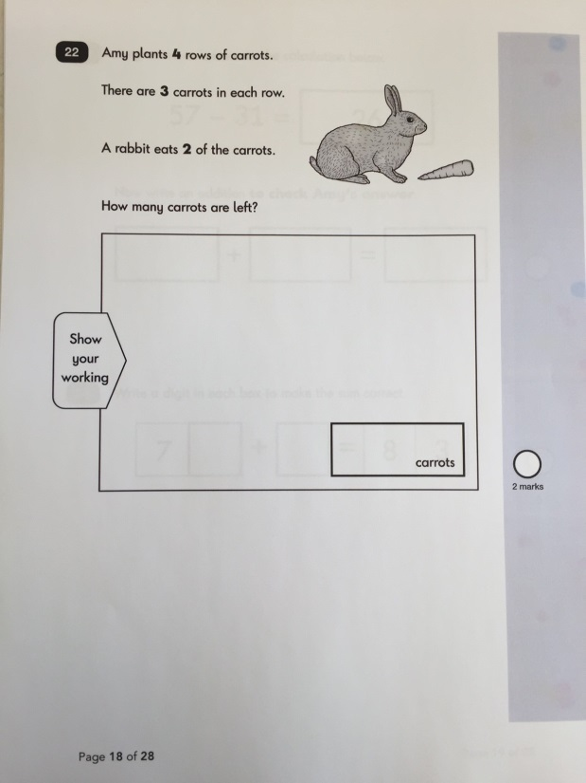
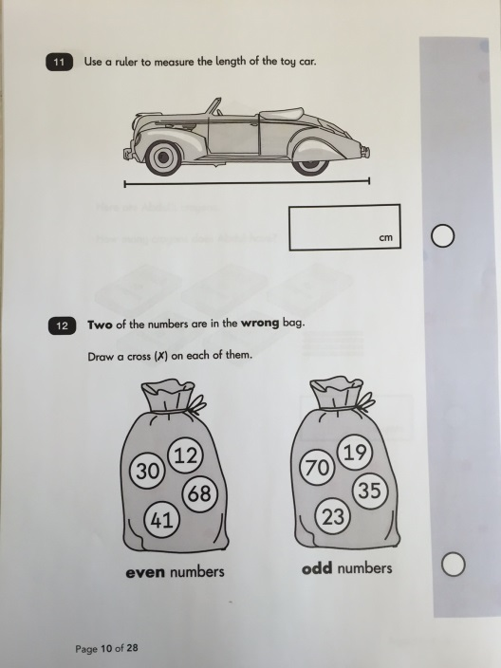
Maths Reasoning Paper
35 minutes approximately
35 marks
Each question comes with a context and a drawing or diagram.
Questions require either a tick in a box, writing a short answer or selecting an answer.
Later questions will require the children to show how they would work out an answer.

Slide 14
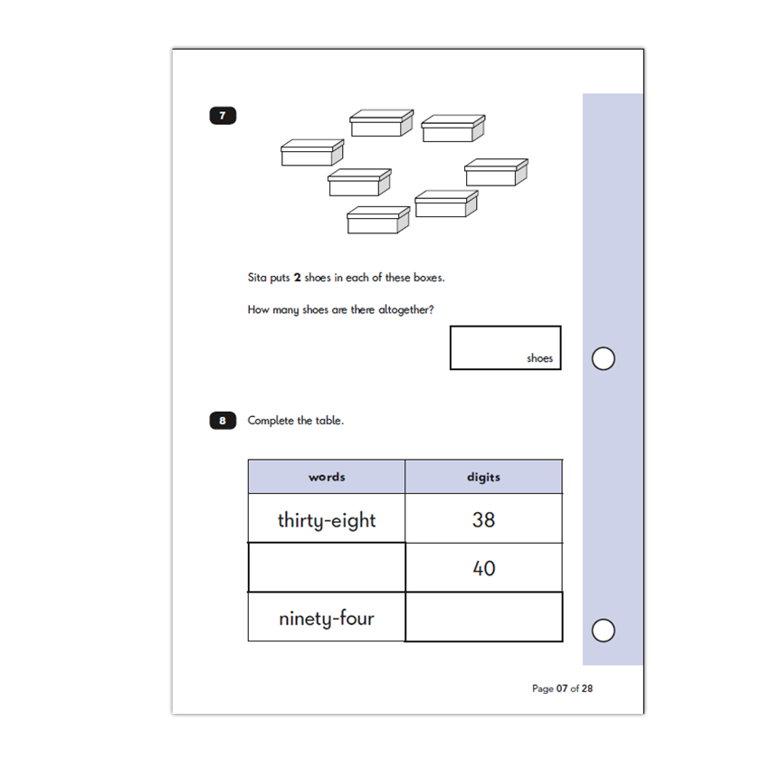
Maths Reasoning Paper

Slide 15
How can we help at home?
Revise and recall times tables both in order and out of order.
Counting in 2s, 5s, and 10s but not always from 0.
Addition, subtraction and fractions
Real life maths e.g. baking, number lines/scales, shapes, time and money

Slide 16
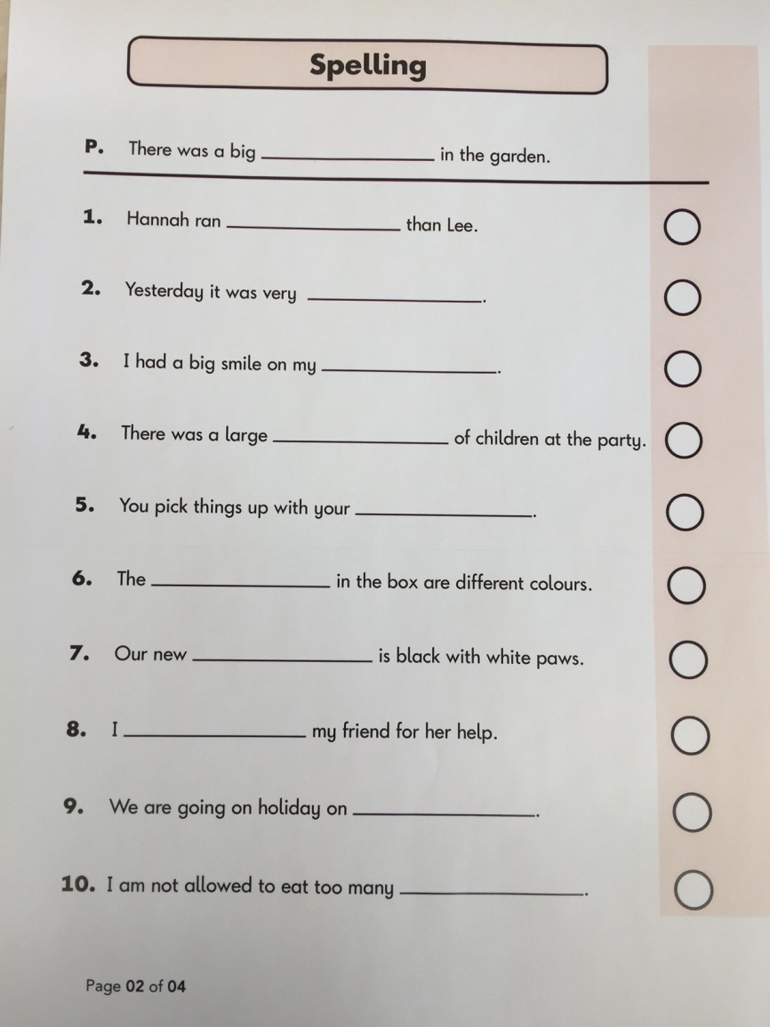
Spelling Paper
15 minutes approximately
20 marks
20 words from KS1 curriculum.
Spellings will be read as part of a sentence.
The words get harder as test goes along.
The easier ones to start follow spelling patterns.
The harder ones require the children to know spelling rules such as the plural of teddy is teddies – take off the y and add –ies.

Slide 17
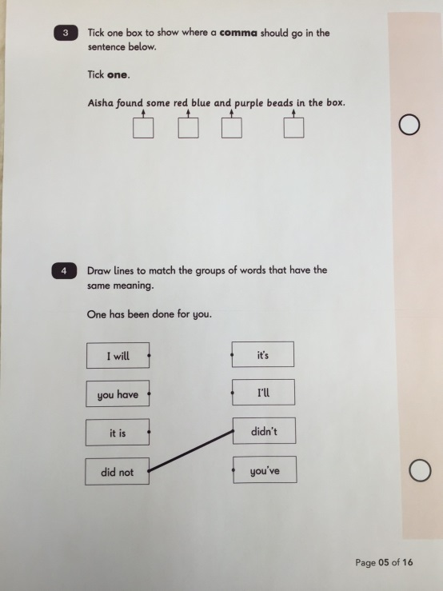
Grammar and Punctuation Paper
20 minutes approximately
20 marks
Tests various aspects of grammar and punctuation.
Children know about verbs, nouns, adjectives, adverbs.
Past and Present Tense.
Sentence types– command, question, exclamation, statement.
Use different types of punctuation correctly.
Combined score from spelling test and Grammar & Punctuation tests are used to aid teachers making a judgement on the children’s writing.

Slide 18
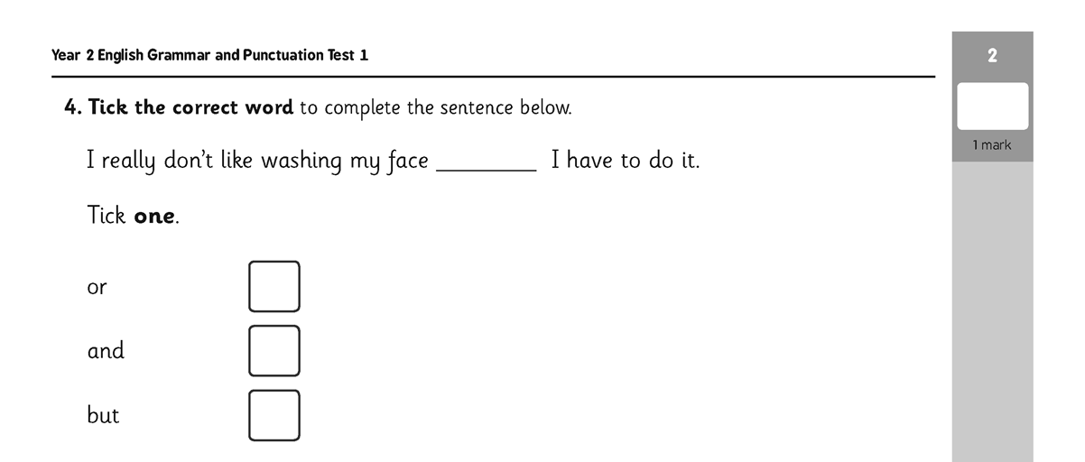
Grammar and Punctuation Paper

Slide 19
Writing & Science
Ongoing teacher assessment, no formal tests.
End of year judgements will be based on the work completed throughout the year. Judgments may be moderated by the local authority.

Slide 20
Reporting Results
Tests marked by the teacher and judgements submitted to the local authority.
Convert the test scores into a ‘standardised score’ using the government provided document.
Conversion tables are not usually released until June.
You will be informed of your child's results in their school report at the end of the year.

Slide 21
Any Questions?
Thank you for coming.

